Slide 1
Solving problems by searching
Chapter 3

Slide 2
Why Search?
To achieve goals or to maximize our utility we need to predict what the result of our actions in the future will be.
There are many sequences of actions, each with their own utility.
We want to find, or search for, the best one.

Slide 3
Problem Solving Agent
Goal Based Agent: Problem-solving agents use atomic representations that is, states of the world are considered as wholes, with no internal structure visible to the problem solving algorithms.
Goal-based agents that use more advanced factored or structured representations
are usually called planning agents

Slide 4
Search Algorithms
UnInformed search algorithms—algorithms that are given no information about the problem other than its definition.
Although some of these algorithms can solve any solvable problem, none of them can do so efficiently.
Informed search algorithms, on the other hand, can do quite well given some guidance on where to look for solutions.

Slide 5
Case study : Touring Agent
Intelligent agents are supposed to maximize their performance measure.
an agent in the city of Arad, Romania, enjoying a touring holiday. The agent’s performance measure contains many factors: it wants to improve its suntan, improve its Romanian, take in the sights, enjoy the nightlife (such as it is), avoid hangovers, and so on
The decision problem is a complex one involving many tradeoffs and careful reading of guidebooks.
Now, suppose the agent has a nonrefundable ticket to fly out of Bucharest the following day.

Slide 6
Touring Agent
the agent to adopt the goal of getting to Bucharest
Goals help organize behavior by limiting the objectives that the agent is trying to achieve and hence the actions it needs to consider.
Goal formulation, based on the current situation and the agent’s performance
measure, is the first step in problem solving.

Slide 7
Touring Agent
goal : a set of world states—exactly those states
Problem formulation is the process of deciding what actions and states to consider, given a goal.- [unknown , (known)Map ]
an agent with several immediate options of unknown value can decide what to do by first examining future actions that eventually lead to states of known value.

Slide 8
TA
the solution to any problem is a fixed sequence of actions.
The process of looking for a sequence of actions that reaches the goal is called search.
A search algorithm takes a problem as input and returns a solution in the form of an action sequence.
Once a solution is found, the actions it recommends can be carried out. This is called the execution phase.

Slide 9
properties of the environment -TA
Observable: agent always knows the current state
Discrete:at any given state there are only finitely many actions to choose from.
Known:the agent knows which states are reached by each action.
Deterministic: so each action has exactly one outcome.

Slide 10
summary
It first formulates a goal and a problem,
searches for a sequence of actions that would solve the problem, and then executes the actions one at a time. When this is complete, it formulates another goal and starts over.

Slide 11
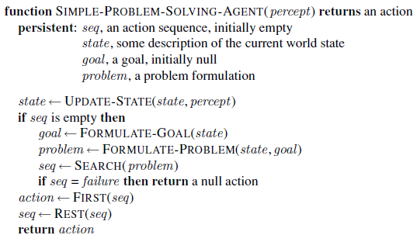
A simple problem-solving agent.

Slide 12
Example: Romania
On holiday in Romania; currently in Arad.
Flight leaves tomorrow from Bucharest
Formulate goal:
  be in Bucharest
Formulate problem:
  states: various cities
  actions: drive between cities or choose next city
Find solution:
  sequence of cities, e.g., Arad, Sibiu, Fagaras, Bucharest

Slide 13

Example: Romania

Slide 14
Problem Formulation
A problem is defined by 5 components:
1.initial state : (particular state s) the agent starts in. e.g., In(Arad)
2.actions / Successor :ACTIONS(s) S(x) = set of action–state pairs
the applicable actions are In(Arad), {Go(Sibiu), Go(Timisoara), Go(Zerind)}.
3.Transition model: RESULT(s, a) that returns the state that results from doing action a in state s.
successor : to refer to any state reachable from a given state by a single action
RESULT(In(Arad),Go(Zerind)) = In(Zerind)
State Space : 1,2 : the set of all states reachable from the initial state by any sequence of actions.
The state space forms a directed network or graph in which the nodes
are states and the links between nodes are actions.

Slide 15
Problem Formulation
A path in the state space is a sequence of states connected by a sequence of actions.
4. goal test :which determines whether a given state is a goal state.
Ex: singleton set {In(Bucharest )}.
Sometimes the goal is specified by an abstract property rather than an explicitly enumerated set of states. For example, in chess, the goal is to reach a state called “checkmate,” where the opponent’s king is under attack and can’t escape.
5. path cost :function that assigns a numeric cost to each path.
  e.g., sum of distances, number of actions executed, etc.
  c(x ,a, y) is the step cost, assumed to be ≥ 0
A solution is a sequence of actions leading from the initial state to a goal state
Solution quality is measured by the path cost function, and an optimal solution has the lowest path cost among all solutions.

Slide 16
Selecting a state space
Real world is absurdly complex
  → state space must be abstracted for problem solving
(Abstract) state = set of real states
(Abstract) action = complex combination of real actions
  e.g., "Arad → Zerind" represents a complex set of possible routes, detours, rest stops, etc.
For guaranteed realizability, any real state "in Arad” must get to some real state "in Zerind”
(Abstract) solution =
  set of real paths that are solutions in the real world
Each abstract action should be "easier" than the original problem

Slide 17
Problem types
Static / Dynamic
Previous problem was static: no attention to changes in environment
Observable / Partially Observable / Unobservable
Previous problem was observable: it knew initial state.
Deterministic / Stochastic
Previous problem was deterministic: no new percepts
were necessary, we can predict the future perfectly given our actions
Discrete / continuous
Previous problem was discrete: we can enumerate all possibilities

Slide 18
Example: vacuum world
states? discrete: dirt and robot
Environment with n locations has n2^{n} states.
initial state? Any
actions? Left, Right, Suck
Transition model? The actions have their expected effects, except that moving Left in the leftmost square, moving Right in the rightmost square, and Sucking in a clean square have no effect.
goal test? no dirt at all locations
path cost? 1 per action

Slide 19

Example: vacuum world
Observable, start in #5. Solution?
n2n
2 x 2 ²

Slide 20
Example: vacuum world
Observable, start in #5.
Solution? [Right, Suck]
Unobservable, start in
{1,2,3,4,5,6,7,8} e.g.,
Solution?

Slide 21

Vacuum world state space graph

Slide 22
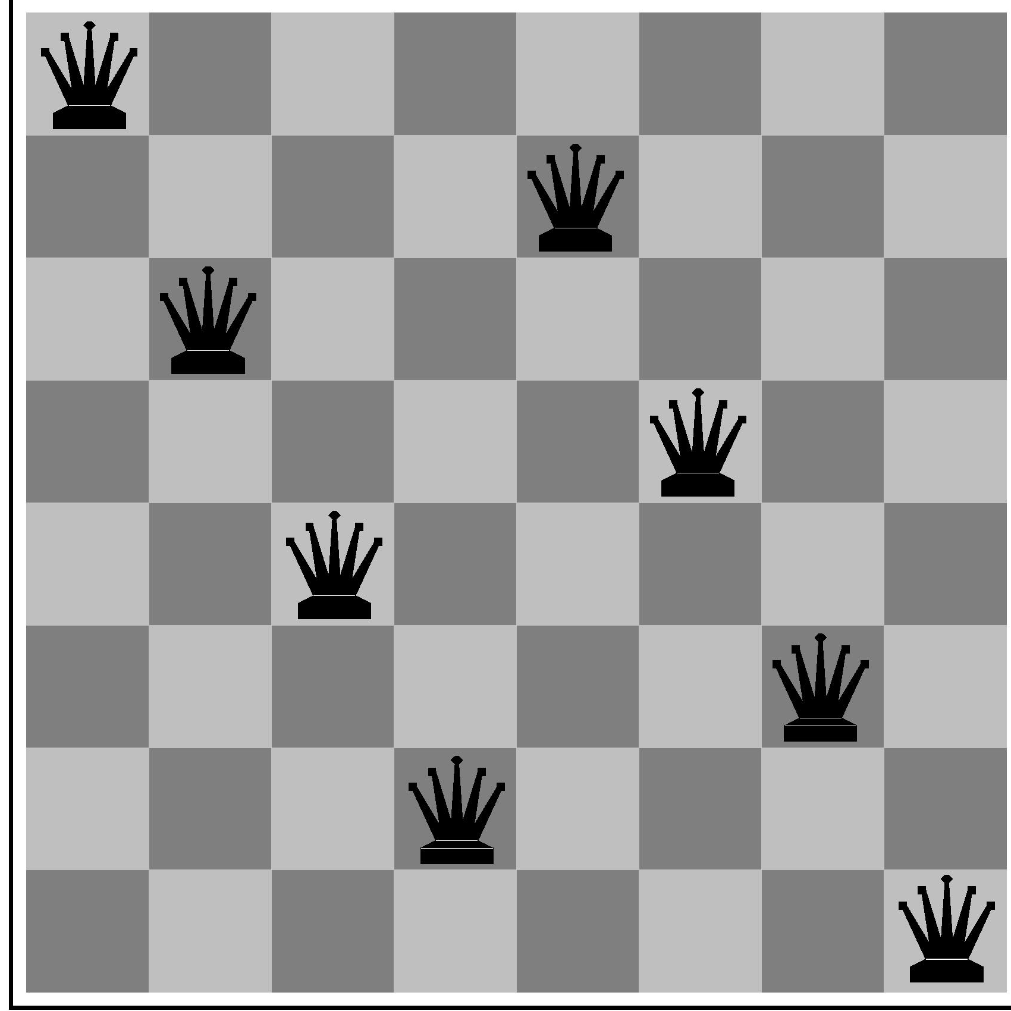
Example: 8-Queens
states? -any arrangement of n<=8 queens
-or arrangements of n<=8 queens in leftmost n
columns, 1 per column, such that no queen
attacks any other.
initial state? incremental formulation : no queens on the board
complete-state formulation starts with all 8 queens on the board

Slide 23
8-Queens
actions? -add queen to any empty square
-or add queen to leftmost empty square such that it is not attacked by other queens. /move the queen around
Transition model? Returns the board with a queen added to the specified square.
goal test? 8 queens on the board, none attacked.
path cost? 1 per move
possible sequences to investigate:
1.8×10¹⁴ possible sequences to investigate.
npr -> n! = 1.2688693218588E+89 n ----- 64, r --→8
(n-r)! = 7.1099858780486E+74
^{n}P_{r} = n!/(n-r)!
^{n}P_{r} = 1.2688693218588E+89/7.1099858780486E+74
^{n}P_{r} = 1.7846298763776E+14

Slide 24

Example: robotic assembly
states?: real-valued coordinates of robot joint angles parts of the object to be assembled
initial state?: rest configuration
actions?: continuous motions of robot joints
goal test?: complete assembly
path cost?: time to execute

Slide 25

Example: The 8-puzzle
states?
initial state?
actions?
goal test?
path cost?

Slide 26
Example: The 8-puzzle
states? locations of tiles, blank in one.
initial state? given
actions? move blank left, right, up, down
Transitional model: ? Given a state and action, this returns the resulting state
goal test? goal state (given)
path cost? 1 per move Abstractions?

Slide 27
The 8-puzzle
Note that any given goal can be reached from exactly half of the possible initial states
[Note: optimal solution of n-Puzzle family is NP-hard]
The 8-puzzle has 9!/2=181, 440 reachable
states and is easily solved.

Slide 28
SEARCHING FOR SOLUTIONS
A solution is an action sequence, so search algorithms work by considering various possible action sequences.
The possible action sequences starting at the initial state form a search tree with the initial state at the root; the branches are actions and the nodes correspond to states in the state space of the problem.

Slide 29
Tree search algorithms
Basic idea:
  Exploration of state space by generating successors of already-explored states (a.k.a.~expanding states).
  Every states is evaluated: is it a goal state?
Nodes that have been expanded are shaded
Nodes that have been generated but not yet expanded are
outlined in bold
nodes that have not yet been generated are shown in faint dashed lines.

Slide 30

Tree search example
In(Arad)

Slide 31

Tree search example
In(Arad)
In(Sibiu), In(Timisoara), and In(Zerind).

Slide 32

Tree search example
parent node
Child nodes
goal state ?
In(Arad), In(Fagaras), In(Oradea), and In(RimnicuVilcea).
leaf node : a node with no children in the tree
The set of all leaf nodes available for expansion at any given
point is called the frontier. Also called as open list.
how they choose which state to expand next—search strategy
In(Arad) is a repeated state in the search tree, generated in this case by a loopy path. - redundant paths.

Slide 33
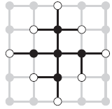
Tree search
redundant paths are unavoidable. This includes all problems where the actions are reversible, such as route-finding problems and sliding-block puzzles. algorithms that forget their history are doomed to repeat it.
The way to avoid exploring redundant paths is to remember where one has been. To do this, we augment the TREE-SEARCH algorithm with a data structure called the explored set (also known as the closed list), which remembers every expanded node. Newly generated nodes that match previously generated nodes—ones in the explored set or the frontier—can be discarded instead of being added to the frontier.

Slide 34

Tree Search Algorithm

Slide 35
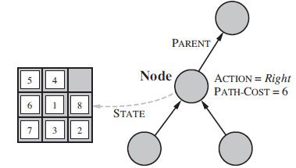
Infrastructure for search algorithms
Search algorithms require a data structure to keep track of the search tree that is being constructed. For each node n of the tree, we have a structure that contains four components:
n.STATE: the state in the state space
to which the node corresponds;
n.PARENT: the node in the search
tree that generated this node;
n.ACTION: the action that was applied
to the parent to generate the node;
n.PATH-COST: the cost, traditionally
denoted by g(n), of the path from the
initial state to the node, as indicated
by the parent pointers.
Arrows point from child to parent.

Slide 36
Implementation
function CHILD-NODE(problem, parent , action) returns a node
return a node with
STATE = problem.RESULT(parent.STATE, action),
PARENT = parent, ACTION = action,
PATH-COST = parent.PATH-COST + problem.STEP-COST(parent.STATE, action)
The appropriate data structure for this is a queue.
The operations on a queue are as follows:
• EMPTY?(queue) returns true only if there are no more elements in the queue.
• POP(queue) removes the first element of the queue and returns it.
• INSERT(element, queue) inserts an element and returns the resulting queue.
FIFO queue, LIFO queue, Priority queue
hash table, a bit-vector representation or a sorted list – to avoid repetition

Slide 37
Measuring problem-solving algorithm performance
A search strategy is defined by picking the order of node expansion
Strategies are evaluated along the following dimensions:
  completeness: does it always find a solution if one exists?
  time complexity: number of nodes generated
  space complexity: maximum number of nodes in memory
  optimality: does it always find a least-cost solution?
Time and space complexity are measured in terms of
  b: maximum branching factor of the search tree
  d: depth of the least-cost solution
  m: maximum depth of the state space (may be ∞)

Slide 38
Search Strategies
The UNINFORMED SEARCH / BLIND SEARCH term means that the strategies have no additional information about states beyond that provided in the problem definition.
All they can do is generate successors and distinguish a goal state from a non-goal state.
All search strategies are distinguished by the order in which nodes are expanded.
Strategies that know whether one non-goal state is “more promising” than another are called informed search or heuristic search strategies;

Slide 39
UNINFORMED SEARCH Strategies
Breadth-first search
Uniform-cost search
Depth-first search
Depth-limited search
Iterative deepening depth-first search
Bidirectional search

Slide 40
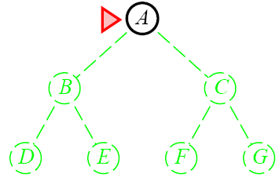
Breadth-First Search
Breadth-first search is an instance of the general graph-search algorithm in
which the shallowest unexpanded node is chosen for expansion.
FIFO queue for the frontier

Slide 41
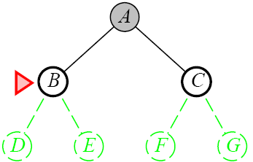
Breadth-First Search
January 26, 2003
AI: Chapter 3: Solving Problems by Searching

Slide 42
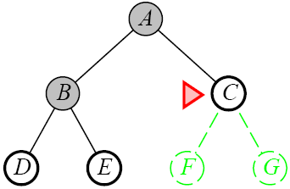
Breadth-First Search
January 26, 2003
AI: Chapter 3: Solving Problems by Searching

Slide 43
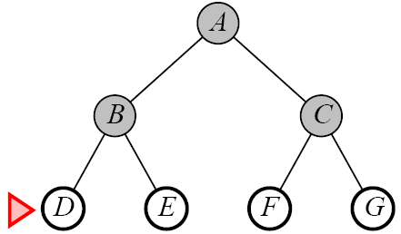
Breadth-First Search
January 26, 2003
AI: Chapter 3: Solving Problems by Searching

Slide 44
Breadth-first search on a graph.
function BREADTH-FIRST-SEARCH(problem) returns a solution, or failure
node ←a node with STATE = problem.INITIAL-STATE, PATH-COST = 0
if problem.GOAL-TEST(node.STATE) then return SOLUTION(node)
frontier ←a FIFO queue with node as the only element
explored ←an empty set
loop do
if EMPTY?( frontier) then return failure
node←POP( frontier ) /* chooses the shallowest node in frontier */
add node.STATE to explored
for each action in problem.ACTIONS(node.STATE) do
child ←CHILD-NODE(problem, node, action)
if child .STATE is not in explored or frontier then
if problem.GOAL-TEST(child .STATE) then return SOLUTION(child )
frontier ←INSERT(child , frontier )

Slide 45
Breadth-First
Enqueue nodes on nodes in FIFO (first-in, first-out) order.
Complete : It is guaranteed to find a solution.
Optimal (i.e., admissible) if all operators have the same cost. Otherwise, not optimal but finds solution with shortest path length.
Exponential time complexity :
where d is the depth of the solution and
b is the branching factor (i.e., number of children) at each node
  the total number of nodes generated is
  1 + b + b² + ... + b^{d} = O(b^{d} )
If the algorithm were to apply the goal test to nodes when selected for expansion,
rather than when generated, the whole layer of nodes at depth d would be expanded
before the goal was detected and the time complexity would be O(b^{d+1}).)

Slide 46
BFS
  space complexity :
For breadth-first graph search in particular, every node generated remains in memory.
There will be O(b^{d−1}) nodes in the explored set and O(b^{d}) nodes in the frontier,

Slide 47
Uniform-Cost Search
Same idea as the algorithm for breadth-first search…but…
  Expand the least-cost unexpanded node
  FIFO queue is ordered by cost
  Equivalent to regular breadth-first search if all step costs are equal

Slide 48

Uniform-Cost Search
Complete
  Yes if the cost is greater than some threshold
  step cost >= ε
Time
  Complexity cannot be determined easily by d or d
  Let C* be the cost of the optimal solution
  O(b^{ceil(C*/ ε)})
Space
  O(b^{ceil(C*/ ε)})
Optimal
  Yes, Nodes are expanded in increasing order

Slide 49
Uniform-Cost (UCS)
Enqueue nodes by path cost. That is, let g(n) = cost of the path from the start node to the current node n. Sort nodes by increasing value of g.
Called “Dijkstra’s Algorithm” in the algorithms literature and similar to “Branch and Bound Algorithm” in operations research literature
Complete (*)
Optimal/Admissible (*)
Admissibility depends on the goal test being applied when a node is removed from the nodes list, not when its parent node is expanded and the node is first generated
Exponential time and space complexity, O(bd)

Slide 50
Depth-First Search
Recall from Data Structures the basic algorithm for a depth-first search on a graph or tree
Expand the deepest unexpanded node
Unexplored successors are placed on a stack until fully explored
January 26, 2003
AI: Chapter 3: Solving Problems by Searching

Slide 51
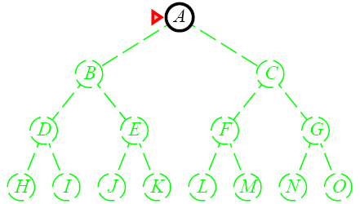
Depth-First Search
January 26, 2003
AI: Chapter 3: Solving Problems by Searching

Slide 52
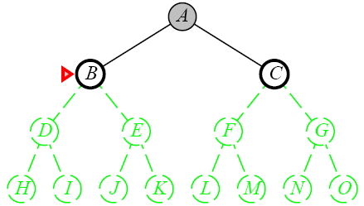
Depth-First Search
January 26, 2003
AI: Chapter 3: Solving Problems by Searching

Slide 53
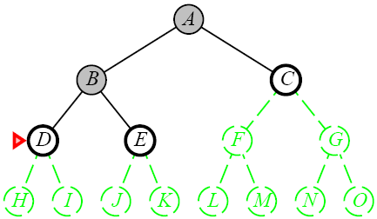
Depth-First Search
January 26, 2003
AI: Chapter 3: Solving Problems by Searching

Slide 54
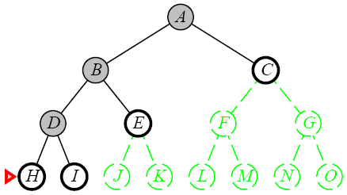
Depth-First Search
January 26, 2003
AI: Chapter 3: Solving Problems by Searching

Slide 55
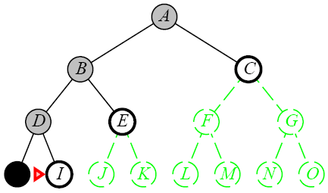
Depth-First Search
January 26, 2003
AI: Chapter 3: Solving Problems by Searching

Slide 56
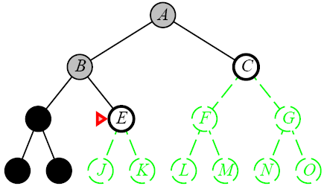
Depth-First Search
January 26, 2003
AI: Chapter 3: Solving Problems by Searching

Slide 57
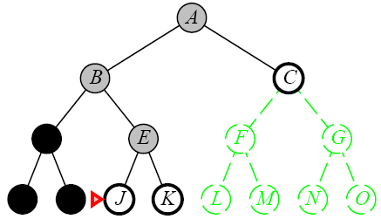
Depth-First Search
January 26, 2003
AI: Chapter 3: Solving Problems by Searching

Slide 58

Depth-First Search
January 26, 2003
AI: Chapter 3: Solving Problems by Searching

Slide 59
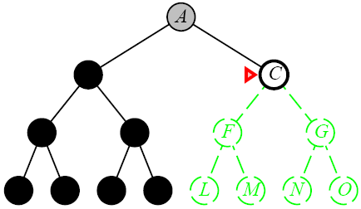
Depth-First Search
January 26, 2003
AI: Chapter 3: Solving Problems by Searching

Slide 60
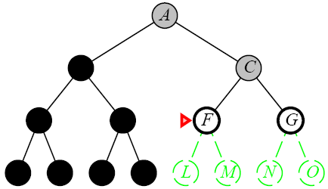
Depth-First Search
January 26, 2003
AI: Chapter 3: Solving Problems by Searching

Slide 61
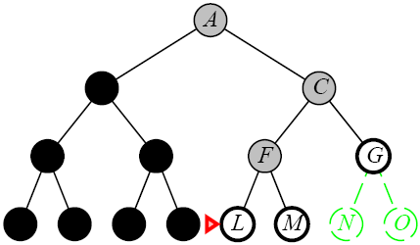
Depth-First Search
January 26, 2003
AI: Chapter 3: Solving Problems by Searching

Slide 62
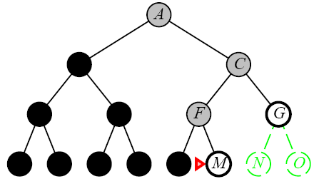
Depth-First Search
January 26, 2003
AI: Chapter 3: Solving Problems by Searching

Slide 63
Depth-First Search
Complete
  No: fails in infinite-depth spaces, spaces with loops
    Modify to avoid repeated spaces along path
  Yes: in finite spaces
Time
  O(b^{m})
  Not great if m is much larger than d
  But if the solutions are dense, this may be faster than breadth-first search
Space
  O(bm)…linear space
Optimal
  No
January 26, 2003
AI: Chapter 3: Solving Problems by Searching

Slide 64
Depth-First (DFS)
Enqueue nodes on nodes in LIFO (last-in, first-out) order. That is, nodes used as a stack data structure to order nodes.
May not terminate without a “depth bound,” i.e., cutting off search below a fixed depth D ( “depth-limited search”)
Not complete (with or without cycle detection, and with or without a cutoff depth)
Exponential time, O(bd), but only linear space, O(bd)
Can find long solutions quickly if lucky (and short solutions slowly if unlucky!)
When search hits a dead-end, can only back up one level at a time even if the “problem” occurs because of a bad operator choice near the top of the tree. Hence, only does “chronological backtracking”

Slide 65
Depth-Limited Search
A variation of depth-first search that uses a depth limit
  Alleviates the problem of unbounded trees
  Search to a predetermined depth l (“ell”)
  Nodes at depth l have no successors
Same as depth-first search if l = ∞
Can terminate for failure and cutoff
January 26, 2003
AI: Chapter 3: Solving Problems by Searching

Slide 66
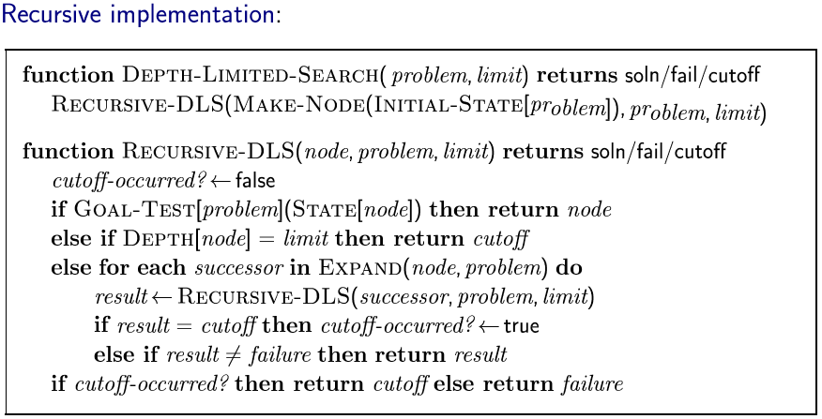
Depth-Limited Search
January 26, 2003
AI: Chapter 3: Solving Problems by Searching

Slide 67
Depth-Limited Search
Complete
  Yes if l < d
Time
  O(b^{l})
Space
  O(bl)
Optimal
  No if l > d
January 26, 2003
AI: Chapter 3: Solving Problems by Searching

Slide 68
Iterative Deepening Search
Iterative deepening depth-first search
  Uses depth-first search
  Finds the best depth limit
    Gradually increases the depth limit; 0, 1, 2, … until a goal is found
January 26, 2003
AI: Chapter 3: Solving Problems by Searching

Slide 69
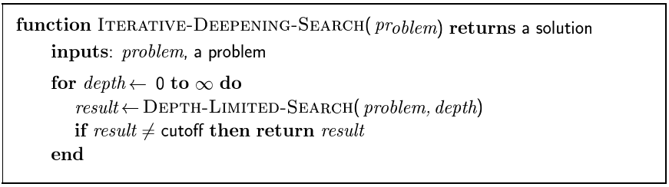
Iterative Deepening Search
January 26, 2003
AI: Chapter 3: Solving Problems by Searching

Slide 70

Iterative Deepening Search
January 26, 2003
AI: Chapter 3: Solving Problems by Searching

Slide 71
Iterative Deepening Search
January 26, 2003
AI: Chapter 3: Solving Problems by Searching

Slide 72
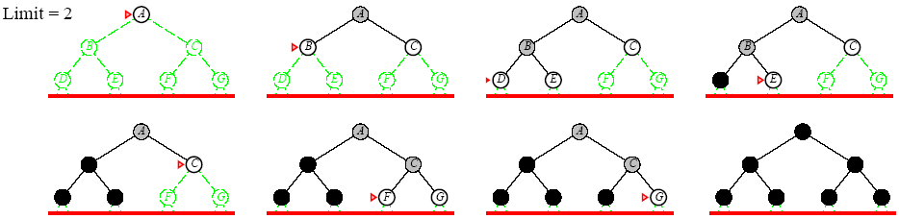
Iterative Deepening Search
January 26, 2003
AI: Chapter 3: Solving Problems by Searching

Slide 73
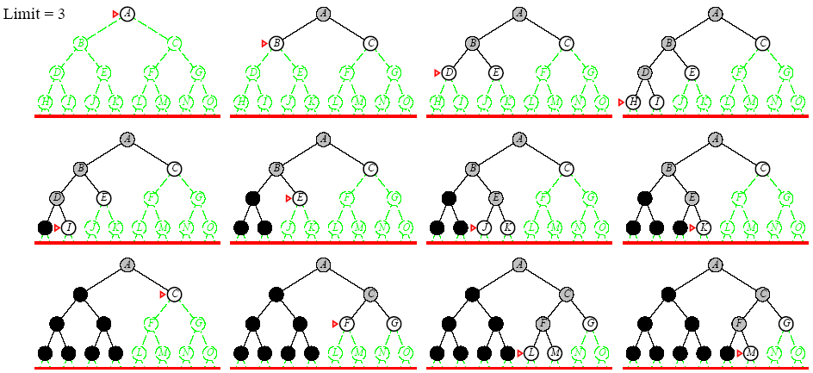
Iterative Deepening Search
January 26, 2003
AI: Chapter 3: Solving Problems by Searching

Slide 74
Iterative Deepening Search
Complete
  Yes
Time
  O(b^{d})
Space
  O(bd)
Optimal
  Yes if step cost = 1
  Can be modified to explore uniform cost tree
January 26, 2003
AI: Chapter 3: Solving Problems by Searching

Slide 75
Lessons From Iterative Deepening Search
Faster than BFS even though IDS generates repeated states
  BFS generates nodes up to level d+1
  IDS only generates nodes up to level d
In general, iterative deepening search is the preferred uninformed search method when there is a large search space and the depth of the solution is not known
January 26, 2003
AI: Chapter 3: Solving Problems by Searching

Slide 76
Avoiding Repeated States
Complication of wasting time by expanding states that have already been encountered and expanded before
  Failure to detect repeated states can turn a linear problem into an exponential one
Sometimes, repeated states are unavoidable
  Problems where the actions are reversable
    Route finding
    Sliding blocks puzzles
January 26, 2003
AI: Chapter 3: Solving Problems by Searching

Slide 77
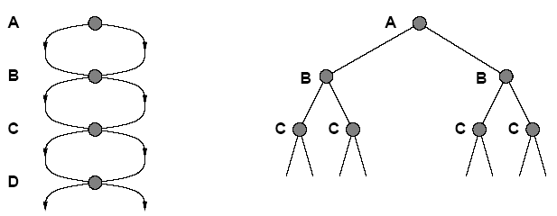
Avoiding Repeated States
State Space
Search Tree
January 26, 2003
AI: Chapter 3: Solving Problems by Searching

Slide 78
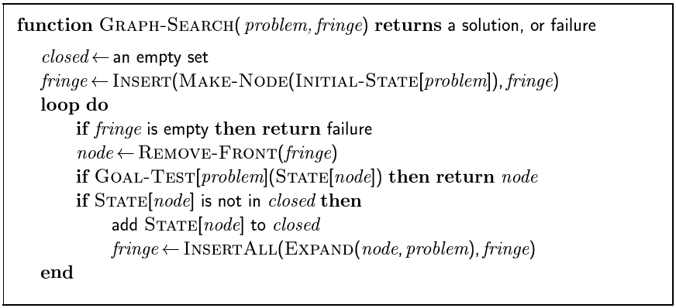
Avoiding Repeated States
January 26, 2003
AI: Chapter 3: Solving Problems by Searching

Slide 79
DFID - summary
First do DFS to depth 0 (i.e., treat start node as having no successors), then, if no solution found, do DFS to depth 1, etc.
    until solution found do
    DFS with depth cutoff c
    c = c+1
Complete
Optimal/Admissible if all operators have the same cost. Otherwise, not optimal but guarantees finding solution of shortest length (like BFS).
Time complexity seems worse than BFS or DFS because nodes near the top of the search tree are generated multiple times, but because almost all of the nodes are near the bottom of a tree, the worst case time complexity is still exponential, O(bd).

Slide 80
Depth-First Iterative Deepening
If branching factor is b and solution is at depth d, then nodes at depth d are generated once, nodes at depth d-1 are generated twice, etc.
  IDS : (d) b + (d-1) b2 + … + (2) b(d-1) + bd = O(bd).
  If b=4, then worst case is 1.78 * 4d, i.e., 78% more nodes searched than exist at depth d (in the worst case).
However, let’s compare this to the time spent on BFS:
  BFS : b + b2 + … + bd + (b(d+1) – b) = O(bd).
  Same time complexity of O(bd), but BFS expands some nodes at depth d+1, which can make a HUGE difference:
    With b = 10, d = 5,
    BFS: 10 + 100 + 1,000 + 10,000 + 100,000 + 999,990 = 1,111,100
    IDS: 50 + 400 + 3,000 + 20,000 + 100,000 = 123,450
IDS can actually be quicker in-practice than BFS, even though it regenerates early states.

Slide 81
Depth-First Iterative Deepening
Exponential time complexity, O(bd), like BFS
Linear space complexity, O(bd), like DFS
Has advantage of BFS (i.e., completeness) and also advantages of DFS (i.e., limited space and finds longer paths more quickly)
Generally preferred for large state spaces where solution depth is unknown

Slide 82
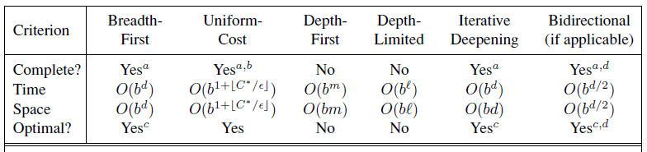
Comparing uninformed search strategies
Evaluation of tree-search strategies: b is the branching factor; d is the depth
of the shallowest solution; m is the maximum depth of the search tree; l is the depth limit.
Superscript caveats are as follows: a complete if b is finite; b complete if step costs ≥ for positive ; c optimal if step costs are all identical; d if both directions use breadth-first search.

Slide 83
Permutations Formula:
P(n,r)=n!(n−r)!P(n,r)=n!(n−r)!
For n ≥ r ≥ 0.
Calculate the permutations for P(n,r) = n! / (n - r)!. "The number of ways of obtaining an ordered subset of r elements from a set of n elements."[1]
Permutation Problem 1
Choose 3 horses from group of 4 horses
In a race of 15 horses you beleive that you know the best 4 horses and that 3 of them will finish in the top spots: win, place and show (1st, 2nd and 3rd). So out of that set of 4 horses you want to pick the subset of 3 winners and the order in which they finish. How many different permutations are there for the top 3 from the 4 best horses?
For this problem we are looking for an ordered subset of 3 horses (r) from the set of 4 best horses (n). We are ignoring the other 11 horses in this race of 15 because they do not apply to our problem. We must calculate P(4,3) in order to find the total number of possible outcomes for the top 3 winners.
P(4,3) = 4! / (4 - 3)! = 24 Possible Race Results
If our 4 top horses have the numbers 1, 2, 3 and 4 our 24 potential permutations for the winning 3 are {1,2,3}, {1,3,2}, {1,2,4}, {1,4,2}, {1,3,4}, {1,4,3}, {2,1,3}, {2,3,1}, {2,1,4}, {2,4,1}, {2,3,4}, {2,4,3}, {3,1,2}, {3,2,1}, {3,1,4}, {3,4,1}, {3,2,4}, {3,4,2}, {4,1,2}, {4,2,1}, {4,1,3}, {4,3,1}, {4,2,3}, {4,3,2}
Permutation Problem 2
Choose 3 contestants from group of 12 contestants
At a high school track meet the 400 meter race has 12 contestants. The top 3 will receive points for their team. How many different permutations are there for the top 3 from the 12 contestants?
For this problem we are looking for an ordered subset 3 contestants (r) from the 12 contestants (n). We must calculate P(12,3) in order to find the total number of possible outcomes for the top 3.
P(12,3) = 12! / (12-3)! = 1,320 Possible Outcomes
Permutation Problem 3
Choose 5 players from a set of 10 players
An NFL team has the 6th pick in the draft, meaning there are 5 other teams drafting before them. If the team believes that there are only 10 players that have a chance of being chosen in the top 5, how many different orders could the top 5 be chosen?
For this problem we are finding an ordered subset of 5 players (r) from the set of 10 players (n).
P(10,5)=10!/(10-5)!= 30,240 Possible Orders

